Slide 1
Software Engineering Project 1 COMP10050 Lecture 2

Slide 2

Objectives
Introduce you to Assignment 1
Use 2-D Arrays to store sentences
Open, Read and Write Files
Create Modules in C

Slide 3

Let’s Have a Look at Assignment 1

Slide 4
Assignment 1
Read/write strings from/to files
Sort strings
Identify anagrams
Identify missing anagrams

Slide 5
Assignment 1
Read/write strings from/to files
→ (Week 2)
Sort strings
→ (Week 3)
Identify anagrams
→ (Week 4-5)
Identify missing anagrams
→ (Week 6)

Slide 6
Use 2D Arrays To Store Strings

Slide 7
Strings – Representation
Strings are represented as an array of characters
C does not restrict the length of the string. The end of the string is specified using \0.

Slide 8
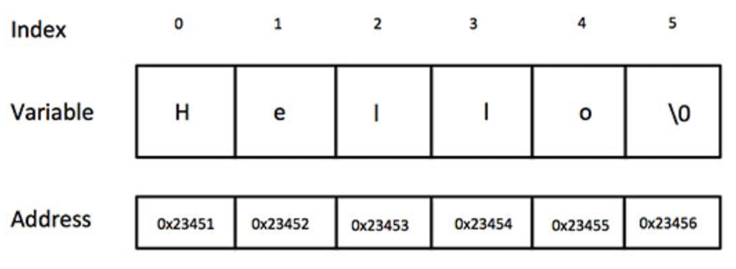
Strings – Representation
Strings are represented as an array of characters
C does not restrict the length of the string. The end of the string is specified using \0.
For instance “Hello” is represented as follows

Slide 9
Strings – Declaration Examples
char str[] = “hello”;
/*compiler takes care of size */
char str[10] = “hello”;
/* make sure the array is large enough */
char str[] = {‘h’,’e’,’l’,’l’,’o’,’\0’}

Slide 10
But How can we store more than one string?

Slide 11
Store a List of Strings
#define MAX_LINES 20
#define MAX_CHAR 60
char sentences[MAX_LINES][MAX_CHAR];
A | c | t | \0
c | u | d | d | l | e | \0
H | E | y |  | t | h | e | r | e | ! | \0
MAX_LINES
. . .

Slide 12
Store a List of Strings
#define MAX_LINES 20
#define MAX_CHAR 60
char sentences[MAX_LINES][MAX_CHAR];
MAX_CHAR
A | c | t | \0
c | u | d | d | l | e | \0
H | E | y |  | t | h | e | r | e | ! | \0
. . .

Slide 13
Print Sentences
#define MAX_LINES 20
#define MAX_CHAR 60
char sentences[MAX_LINES][MAX_CHAR];
A | c | t | \0
c | u | d | d | l | e | \0
H | E | y |  | t | h | e | r | e | ! | \0
. . .
printf(“Character [1][2]: %c”, sentences[1][2]);
Character [1][2]: d

Slide 14
Print Sentences
#define MAX_LINES 20
#define MAX_CHAR 60
char sentences[MAX_LINES][MAX_CHAR];
A | c | t | \0
c | u | d | d | l | e | \0
H | E | y |  | t | h | e | r | e | ! | \0
. . .
printf(“%s”, sentences[1]);
cuddle

Slide 15
File Input and Output

Slide 16
Opening a File
FILE *fopen(const char *path, const char *mode)
fopen(FILE_PATH, “r+”)
Mode can be “r” (read only), “w” (write only), “a” (append)
fopen returns a pointer to the file stream if it exists or NULL otherwise
No need to know the details of the FILE data type
Important: The standard input and output are also FILE* datatypes (stdin,stdout).
Important: stderr corresponds to standard error output (different from stdout)

Slide 17
Closing a File
int fclose(FILE* fp)
fclose(fp)
Closes the stream (releases OS resources).
Returns 0 if the stream is closed successfully. On failure, EOF is returned.
fclose() is automatically called on all open files when program terminates.

Slide 18
File Input
int getc(FILE* fp)
Reads a single character from the stream
Returns the character read or EOF on error/end of file.
Note: getchar simply uses the standard input to read a character. We can implement it as follows:
#define getchar() getc(stdin)

Slide 19
File Input
char* fgets(char *line, int maxlen, FILE *fp)
line – pointer to an array of chars where the string read is stored
Reads a single line (up to a number of characters given by maxlen) from the file input stream fp (including linebreak).
Returns a pointer to the character array that stores the line (read-only)
Return NULL if end of stream

Slide 20
File Output
int putc(int c, FILE* fp)
Writes a single character c to the output stream
Returns the character written or EOF on error
Note: putchar simply uses the standard output to write a character.
We can implement it as follows:
#define putchar() putc(c, stdout)

Slide 21
File Output
int fputs(char *line, FILE *fp)
Writes a single line to the output stream
Returns zero on success, EOF otherwise

Slide 22
Exercise 1
Create a new file and write string “Hello World” in it.

Slide 23
Exercise 1
Create a new file and write string “Hello World” in it.
FILE *fp;
char myString[80];
fp = fopen(“/Users/liliana1/myfile.txt”,”rw”);
fputs(“Hello World”, fp);
fgets(myString, 80, fp);
Printf(“The context f myfile is: %s”, myString);

Slide 24
Exercise 1
Create a new file and write string “Hello World” in it.
FILE *fp;
char myString[80];
fp = fopen(“/Users/liliana1/myfile.txt”,”rw”);
fputs(“Hello World”, fp);
fgets(myString, 80, fp);
Printf(“The context f myfile is: %s”, myString);
Make sure this path exists

Slide 25
Exercise 1
Create a new file and write string “Hello World” in it.
FILE *fp;
char myString[80];
fp = fopen(“/Users/liliana1/myfile.txt”,”rw”);
fputs(“Hello World”, fp);
fgets(myString, 80, fp);
Printf(“The context f myfile is: %s”, myString);
File needs to be read and written

Slide 26
Exercise 1
Create a new file and write string “Hello World” in it.
FILE *fp;
char myString[80];
fp = fopen(“/Users/liliana1/myfile.txt”,”rw”);
fputs(“Hello World”, fp);
fgets(myString, 80, fp);
Printf(“The context f myfile is: %s”, myString);
Writes “Hello World in the file”

Slide 27
Exercise 1
Create a new file and write string “Hello World” in it.
FILE *fp;
char myString[80];
fp = fopen(“/Users/liliana1/myfile.txt”,”rw”);
fputs(“Hello World”, fp);
fgets(myString, 80, fp);
Printf(“The context f myfile is: %s”, myString);
Reads the first 80 characters from the first line of the file.

Slide 28
Exercise 1
Create a new file and write string “Hello World” in it.
FILE *fp;
char myString[80];
fp = fopen(“/Users/liliana1/myfile.txt”,”rw”);
fputs(“Hello World”, fp);
fgets(myString, 80, fp);
printf(“The context f myfile is: %s”, myString);

Slide 29
Exercise 1
Is there anything missing?
FILE *fp;
char myString[80];
fp = fopen(“/Users/liliana1/myfile.txt”,”rw”);
fputs(“Hello World”, fp);
fgets(myString, 80, fp);
printf(“The context f myfile is: %s”, myString);
fclose(fp);

Slide 30
Exercise 1
Will the program still read string “Hello World” correctly?
FILE *fp;
char myString[80];
fp = fopen(“/Users/liliana1/myfile.txt”, “w+”);
fputs(“Hello World”, fp);
fgets(myString, 80, fp);
printf(“The context f myfile is: %s”, myString);

Slide 31
Exercise 1
Will the program still read string “Hello World” correctly?
FILE *fp;
char myString[80];
fp = fopen(“/Users/liliana1/myfile.txt”, “w+”);
fputs(“Hello World”, fp);
fseek(fp, 0, SEEK_SET);
fgets(myString, 80, fp);
printf(“The context f myfile is: %s”, myString);
Moves the file pointer position to the beginning of the file

Slide 32
Exercise 1
Will the program still read string “Hello World” correctly?
FILE *fp;
char myString[80];
fp = fopen(“/Users/liliana1/myfile.txt”, “w+”);
fputs(“Hello World”, fp);
fseek(fp, 0, SEEK_SET);
fgets(myString, 80, fp);
printf(“The context f myfile is: %s”, myString);
SEEK_CUR : move the pointer to the current position
SEEK_END : move the pointer to the end of the file

Slide 33
Create Modules in C

Slide 34

Modularity
Your assignment should be modular and should not be implemented in 1 single file and using a single main function!
main.c
fileIO.c
fileIO.h
Your Assignment 1 CLion Project
sort.c
sort.h
anagram.c
anagram.h

Slide 35
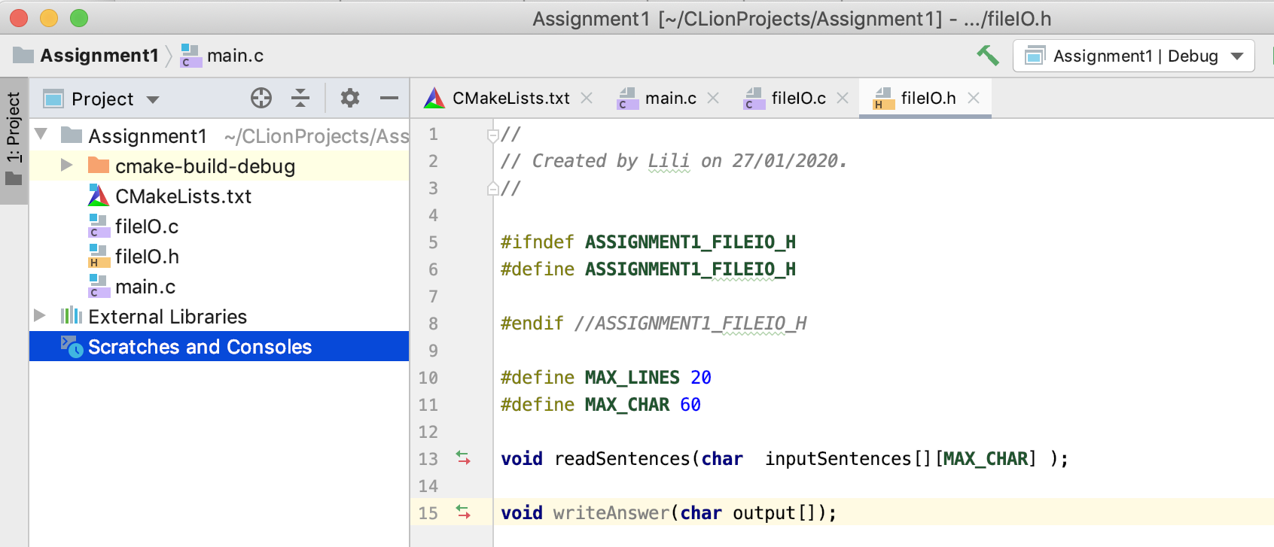
Creating and Using Libraries
fileIO.h ➔ It is a library containing the prototypes of the methods necessary to read and write to/from files
fileIO.c ➔ It is a source file containing the implementation of the methods listed in fileIO.h

Slide 36
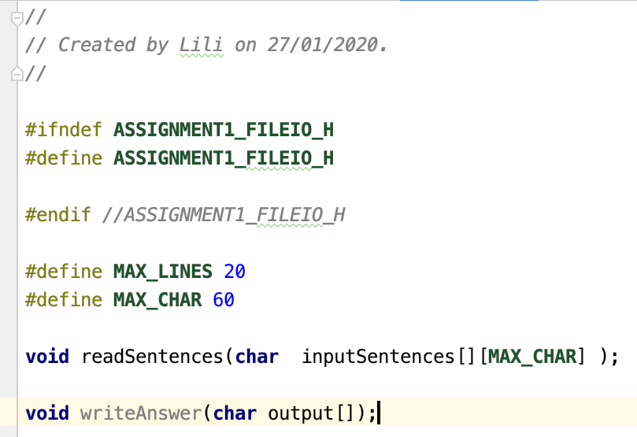
fileIO.h

Slide 37
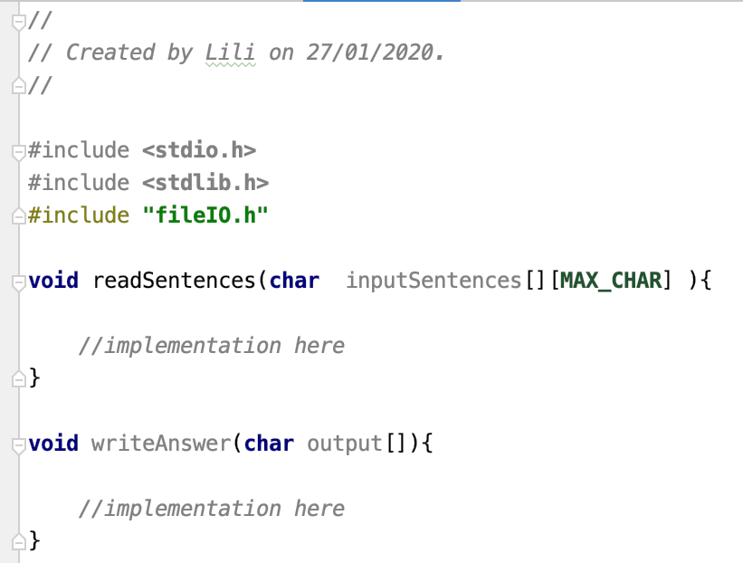
fileIO.c
Includes the library file

Slide 38
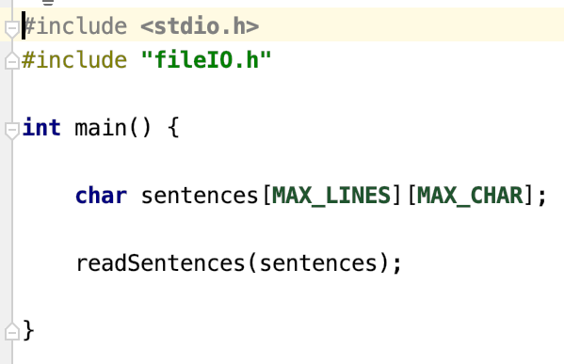
main.c
Includes the library file
Uses methods of the library
Library methods can also be used from other source files.
The important is to declare the library at the beginning!

